Slide 1
Invitation to Python Section 1. Introduction
Lectured by: Dr. Xinzhi ZHANG
Research Assistant Professor, Department of Journalism
Hong Kong Baptist University
24 Nov 2018 @ CVA AI Lab 702

Slide 2
Xinzhi ZHANG [張昕之], Ph.D.
www.drxinzhizhang.com
https://scholar.google.com/citations?user=iOFeIDIAAAAJ&hl=en
@xin_zhi_zhang
https://github.com/xzzhang2
Current Position
Research Assistant Professor, Department of Journalism, Hong Kong Baptist University
Programme Director, the Data and Media Communication Concentration (DMC)

Slide 3
Xinzhi ZHANG [張昕之], Ph.D.
www.drxinzhizhang.com
https://scholar.google.com/citations?user=iOFeIDIAAAAJ&hl=en
@xin_zhi_zhang
https://github.com/xzzhang2
Current Position
Research Assistant Professor, Department of Journalism, Hong Kong Baptist University
Programme Director, the Data and Media Communication Concentration (DMC)

Slide 4





Professional Experience
Research Assistant Professor, Department of Journalism, Hong Kong Baptist University (2016 – Present)
Lecturer, School of Professional Education & Executive Development, The Hong Kong Polytechnic University (2014 – 16)
Postdoctoral Fellow, Department of Media and Communication, City University of Hong Kong (2013 – 14 )
Education
Ph.D. in Media and Communication, City University of Hong Kong (2009 – 13)
M.A. with Distinction, in Communication and New Media, City University of Hong Kong (2008 – 09)
B.A. in Broadcasting Journalism, Guangzhou University, China (2004 – 08)

Slide 5
My research areas
Emerging information and communication technologies and social change
New media and unconventional public expression
Comparative political communication
Digital humanities and digital popular culture
Data-driven journalism and data visualization
Computational methods and digital media
…

Slide 6
My teaching
Multimedia Communication
Humanities
Contexts and Cases
Films and Storytelling
Culture & Ways of Life
Contemporary China
Issues & Cases in Mass Communication
Languages, Cultures, and Communication
Data-driven Journalism Workshop
Invitation to Python
Practical
Theoretical
Social Media Data Acquisition and Processing (with Python)
MA Research Project
Global Communication
Communication Theory
Social Sciences
Theories & Patterns

Slide 7
Why Programming?
Increasing market demands
The digital transformation of the newsrooms
The increasingly presence of data science in the media communication context (”deep fake news”)
Internet is a rich database - digital footprints (digital traces)
The price and difficulty of collecting and storing massive online data has dramatically reduced.
The field itself is becoming more interdisciplinary.

Slide 8
Interdisciplinary
http://chasingdeer.co.uk/analyst-venn-diagram.html
https://www.r-bloggers.com/data-science-in-businesscomputational-social-science-in-academia/
https://knightlab.northwestern.edu/2013/06/28/want-to-build-a-data-journalism-team-youll-need-these-three-people/

Slide 9
Data storage &
management
Data exploration &
data visualization
Data acquisition &
harvesting
Web-tech
Design &
UI UX
MySQL
SQLite
Python
JavaScript
HTML/CSS
Data Science
Computation Social Science
Journalism Studies
Communication Theory

Slide 10
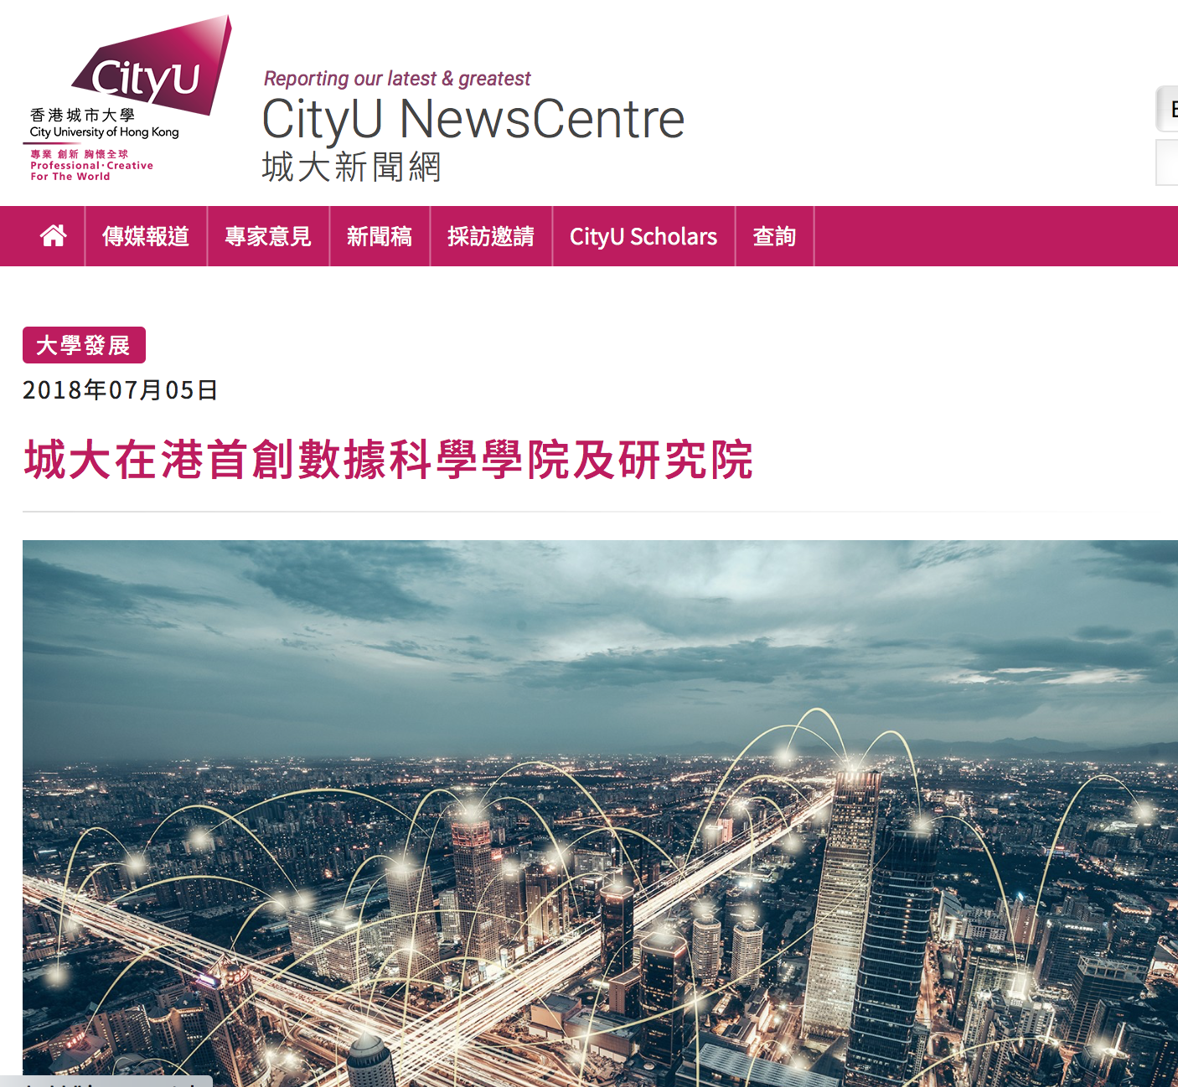
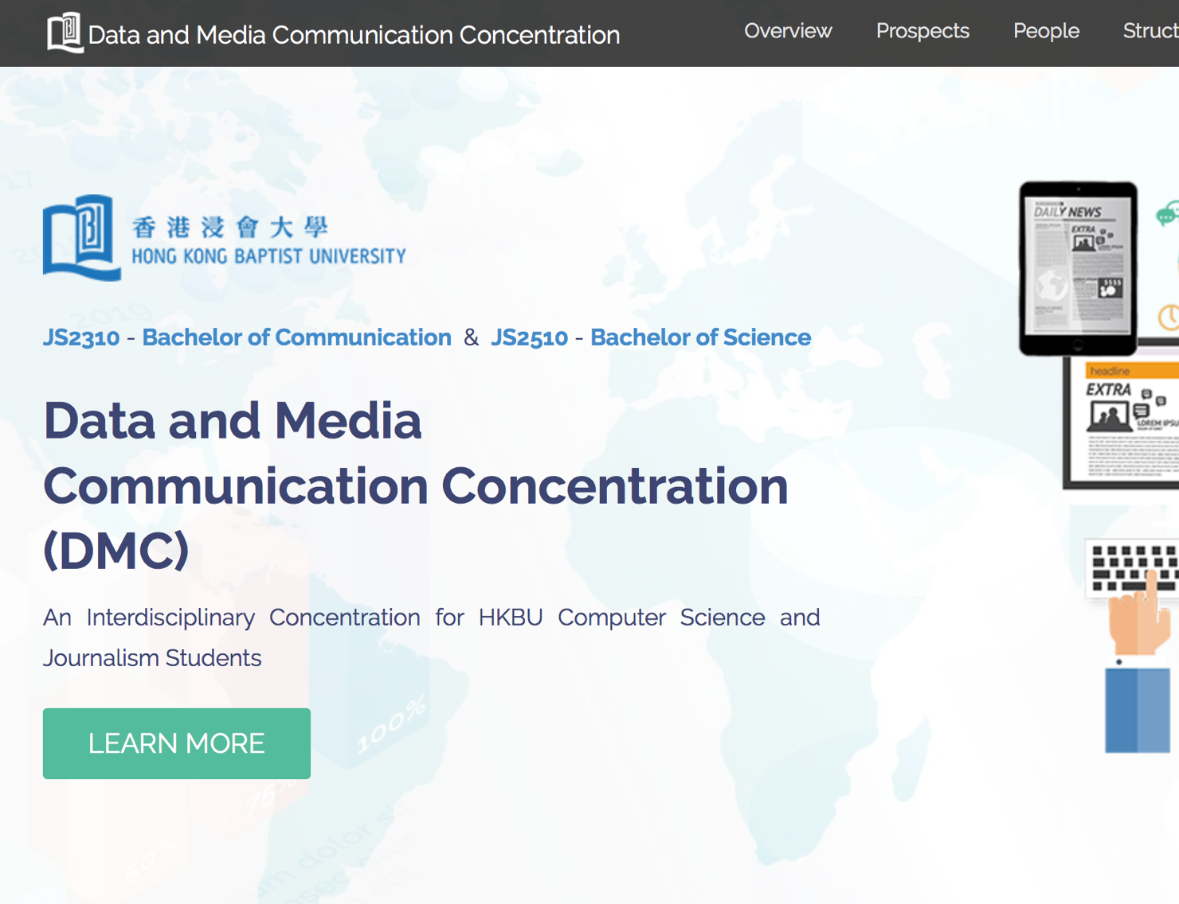
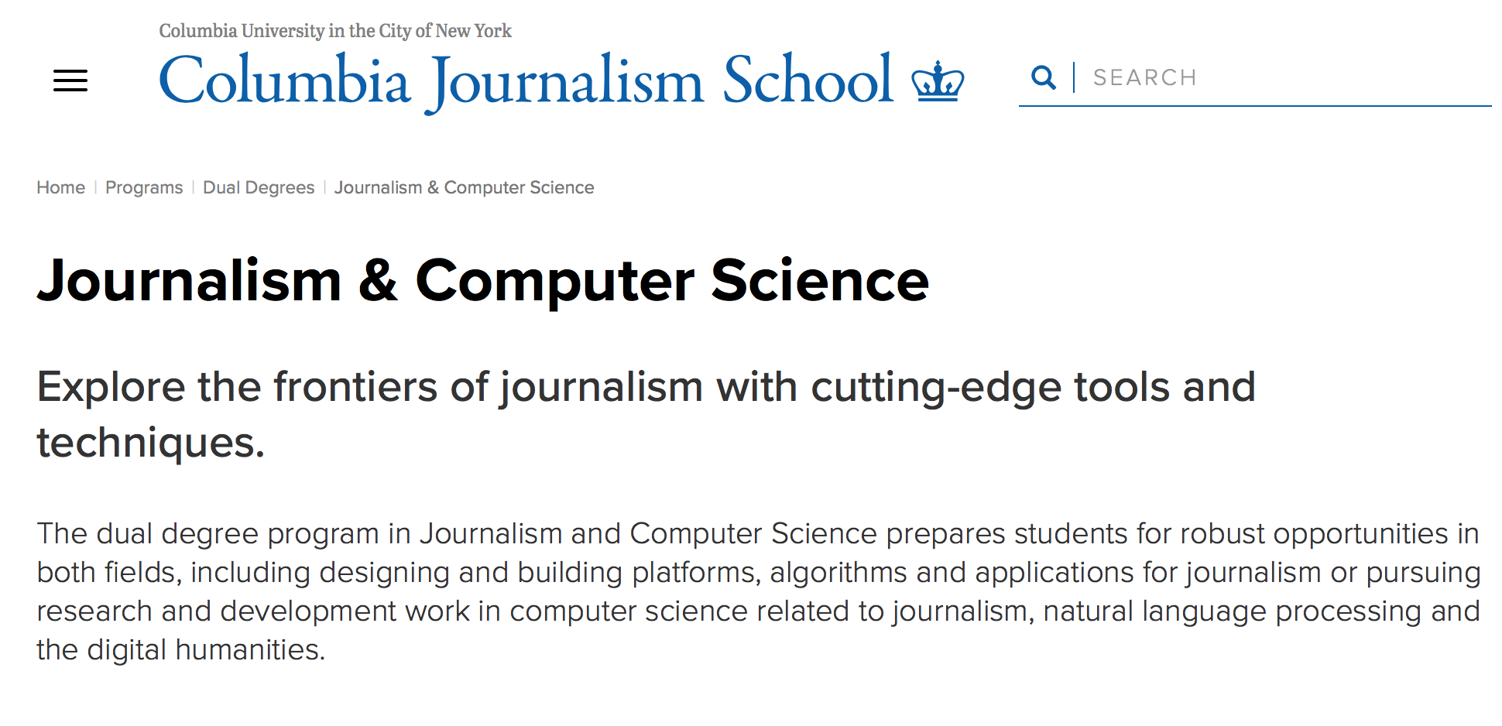

Slide 11
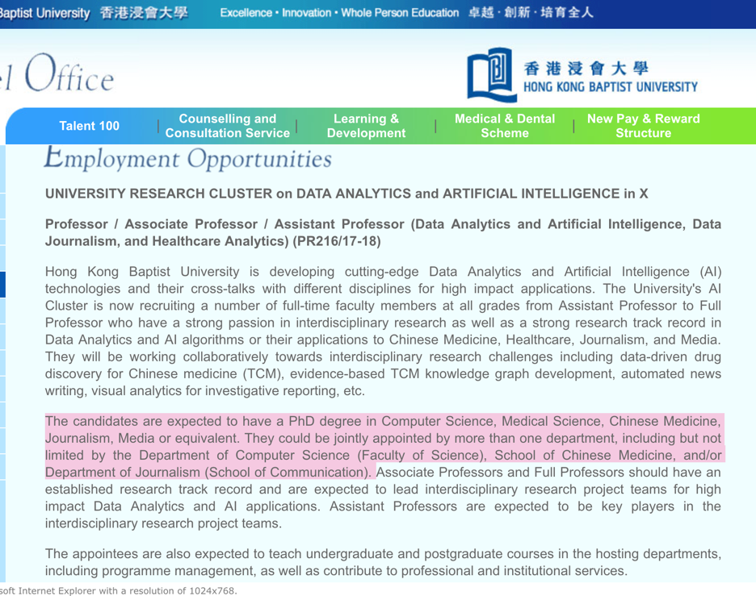
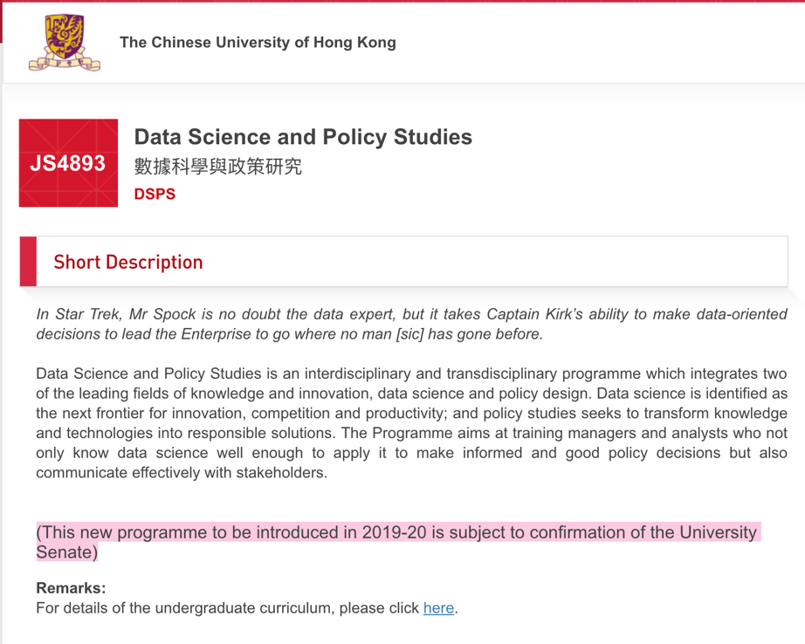
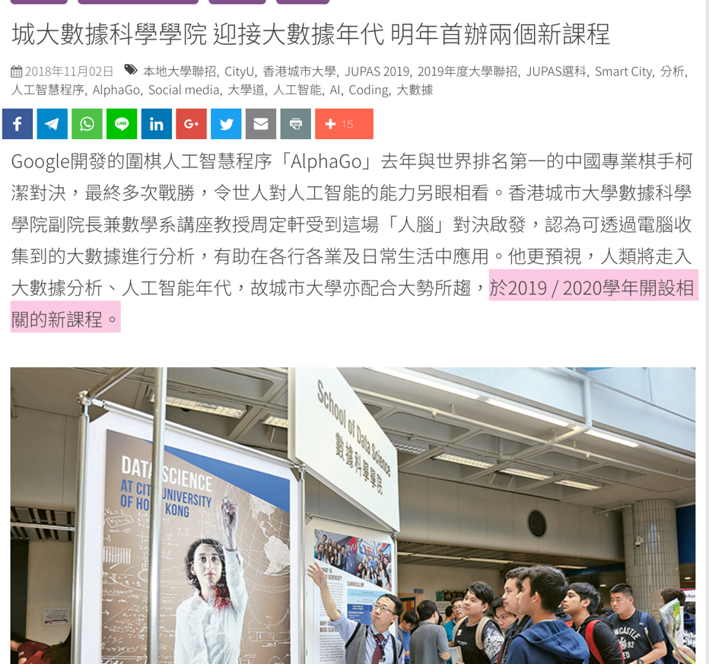
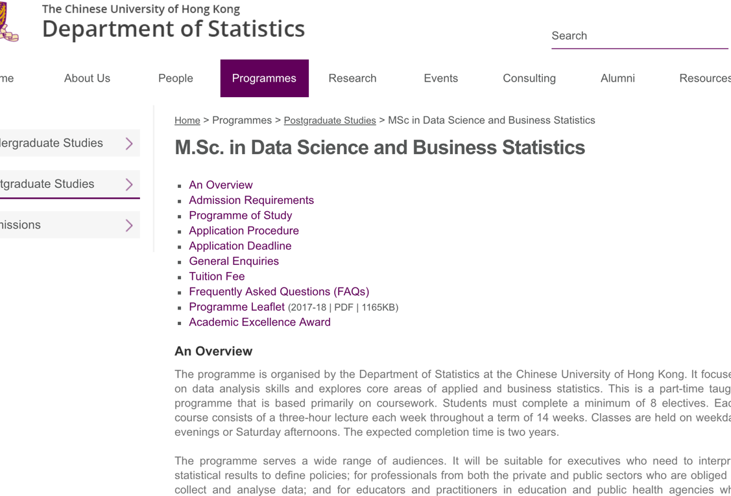

Slide 12
Digital Media Education in Hong Kong
City University of Hong Kong
Master of Arts in Communication and New Media
Since 1998 (the first of this kind in Hong Kong)
Since 2016:
Media Data Analytics Stream
Social Media Data Acquisition and Processing (with Python)
Social Network Analysis for Communication
Media Data Analytics

Slide 13
Digital Media Education in Hong Kong
Chinese University of Hong Kong
Master of Science in New Media
Since 2000
Core courses:
Applied Communication Research
New Communication Technologies: Trends and Impacts
New Media Content Development
New Media Ecology
Elective courses
Digital Humanities (with Python)

Slide 14
Digital Media Education in Hong Kong
University of Hong Kong
Undergraduate
One course on data journalism: Fundamentals of data journalism
Postgraduate
Digital and data (area)
Three areas: reporting and writing; visual and audio; digital and data
Digital and data area:
Special topics in journalism
Research methods for media studies
Data journalism
Social media analytics for journalists
Digital media entrepreneurship
Online courses MOOC with Google News Lab
Online courses (2016, 2017)

Slide 15
Digital Media Education in Hong Kong
Hong Kong Baptist University
Undergraduate
Data and Media Communication Concentration (2017)
JOUR + COMP
2 Years
10 courses, 21 credits
40+ students from JOUR & COMP
Postgraduate
Several elective courses for the existing several programmes:
Big Data Analytics for Media and Communication (2017)
Emerging Information Communication and Technologies (2018)
Algorithmic Culture (2018)
Newly proposed: MSc in AI and Digital Media
School of Communication, supported by the COMP
Since 2019/20
Subject to confirmation to the University Senate

